Slide 1

Oracle Advanced Compression
Krishnaprakash N
GBS IT Innovation Quality

Slide 2
Table Compression
Introduced in Oracle Database 9i Release 2
  Compression during bulk load operations (Direct Load, CTAS)
  Data modified using conventional DML not compressed
Optimized compression algorithm for relational data
Improved performance for queries accessing large amounts of data
  Fewer I/Os
  Buffer Cache efficiency
Data is compressed at the database block level
Compression enabled at either the table or partition level
Completely transparent to applications

Slide 3
OLTP Table Compression
Oracle Database 11g extends table compression for OLTP data
  Support for conventional DML Operations (INSERT, UPDATE)
New algorithm significantly reduces write overhead
  Batched compression minimizes impact for OLTP transactions
No impact on reads
  Reads may actually see improved performance due to fewer I/Os and enhanced memory efficiency

Slide 4
Table Compression
Compression clause can be specified with following options:
  NOCOMPRESS - The table, partition or materialized view is not
  compressed. This is the default action when no compression clause is
  specified.
  COMPRESS - This option is considered suitable for data warehouse
  systems. Compression is enabled on the table or partition during direct-
  path inserts only.
  COMPRESS FOR DIRECT_LOAD OPERATIONS - This option has the
  same affect as the simple COMPRESS keyword.
  COMPRESS FOR ALL OPERATIONS - This option is considered
  suitable for OLTP systems. As the name implies, this option enables
  compression for all operations, including regular DML statements.

Slide 5
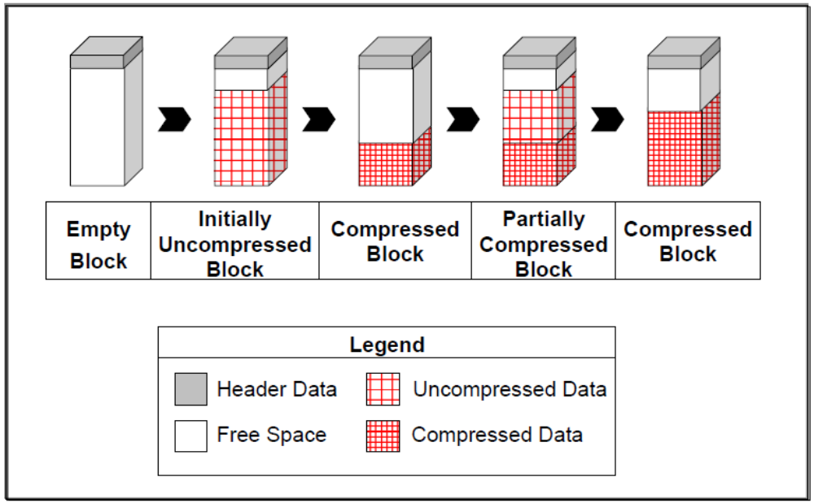
OLTP Table Compression Process

Slide 6
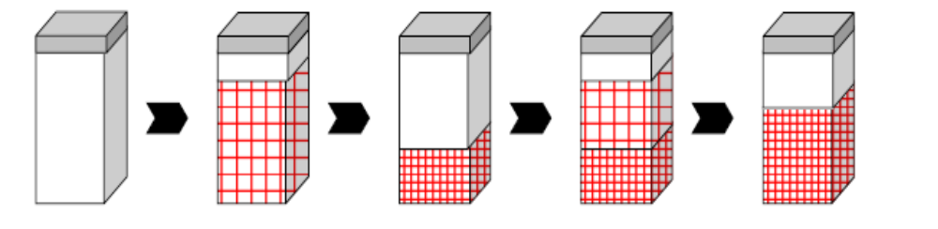
Block-Level Batch Compression
what would happen when inserting into block that is part of a compressed table, the cycle would be like:
  The block is empty and available for inserts.
  When you start inserting into this block, data is stored in an uncompressed format (like for uncompressed tables).
  Individual INSERTs and UPDATEs do not cause recompression
  However, as soon as you reach the PCTFREE of that block, the data is automatically compressed, potentially reducing the space it originally occupied.
  This allows for new uncompressed inserts to take place in the same block, until PCTFREE is reached again. At that point compression is triggered again to reduce space occupation in the block.

Slide 7
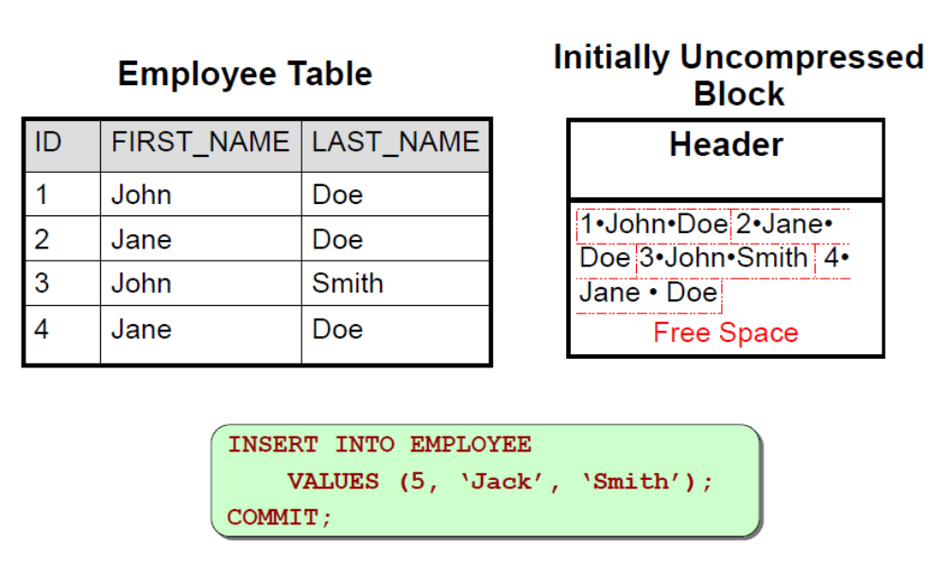
OLTP Table Compression

Slide 8
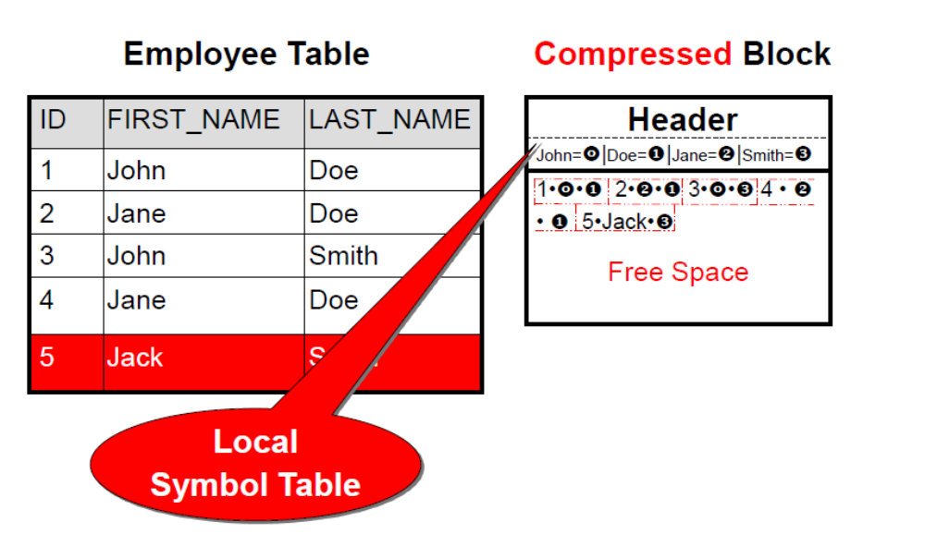
OLTP Table Compression

Slide 9
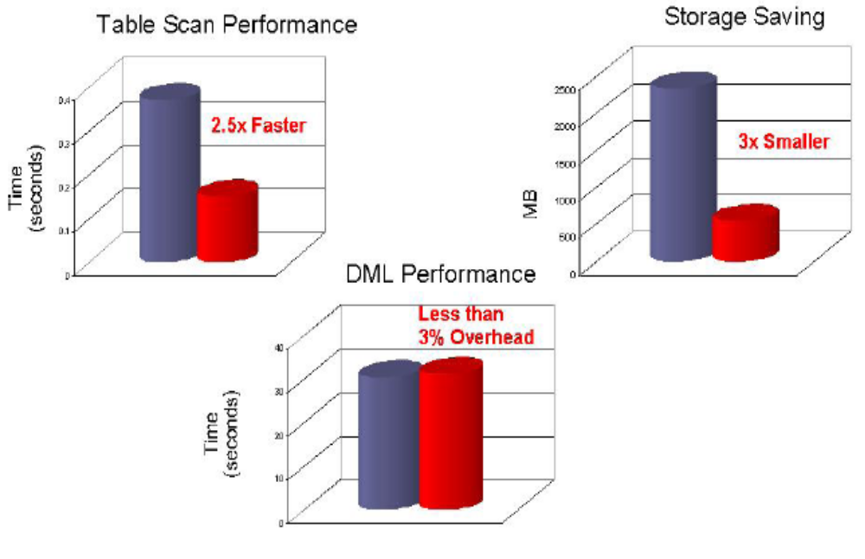
Performance Impact of Compression

Slide 10
How to Enable Table Compression
The example below shows how OLTP Table Compression can be enabled:
CREATE TABLE emp
(emp_id NUMBER,
first_name VARCHAR2(128),
last_name VARCHAR2(128))
COMPRESS FOR ALL OPERATIONS;

Slide 11
Restrictions Associated With Compression
Compressed tables can only have columns added or dropped if the COMPRESS FOR ALL OPERATIONS option was used.
Compressed tables must not have more than 255 columns.
Table compression is only valid for heap organized tables, not index organized tables.
The compression clause cannot be applied to hash or hash-list partitions. Instead, they must inherit their compression settings from the tablespace, table or partition settings.
Table compression cannot be specified for external or clustered tables.

Slide 12
Compression of Data Pump Exports
This feature can be very useful when we need to take a large export on disk but are limited by disk space.
While doing an export, we can use the parameter COMPRESSION=ALL (other options are DATA_ONLY or METADATA) and we see that the size of the dumpfile has reduced very significantly while using this compression feature.
expdp directory=data_file_dir dumpfile=uncompress.dmp schemas=SH compression=ALL

